Slide 1
A Simple Introduction to Scrum Master Certified(SMC)

Slide 2
Overview of Scrum
Scrum is one of popular agile methods.
Provide solutions for traditional project management limitations.
Scrum provides a structure for lifecycle of project.
Provides effective control regarding how projects are initiated, executed and controlled.

Slide 3
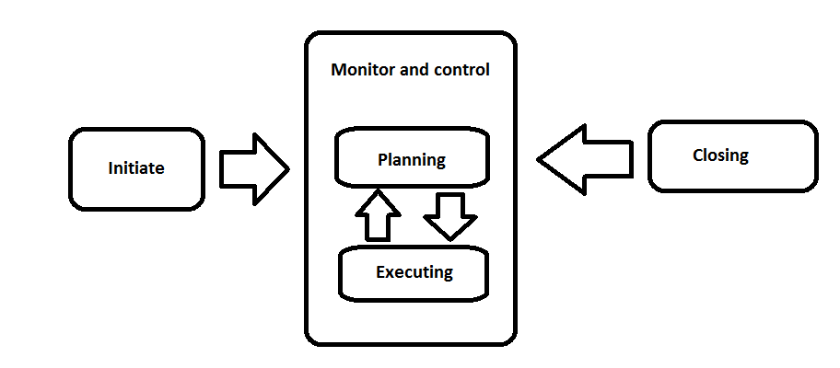
Project Management
Traditional Project Management focus on processes, comprehensive documentation.
Project manager control resource allocation, cost and project schedule.

Slide 4
Agile History
Agile manifesto released on February 2001.
Focus shifted on individuals, interactions, collaboration and responsiveness to change.
The four values of agile manifesto
We are uncovering better ways of developing software by doing it and helping others do it. Through this work we have come to value:
Individuals and Interactions OVER Processes and Tools
Working Software OVER Comprehensive Documentation
Customer Collaboration OVER Contract Negotiation
Responding to change OVER Following a Plan
This is , while there is value in the items on the right, we value the items on the left more.

Slide 5
Agile Manifesto Principles 1-5
1. Our highest priority is to satisfy the customer through early and continuous delivery of valuable software.
2. Welcome changing requirements, even late in development. Agile processes harness change for the customer’s competitive advantage.
3. Deliver working software frequently, from a couple of weeks to a couple of months, with a preference for the shorter timescale.
4. Business people and developers must work together daily throughout the project.
5. Build projects around motivated individual, give them the environment and support they need, and trust them to get the job done.

Slide 6
Agile Manifesto Principles 6-12
6. The most efficient and effective method of conveying information with and within a development team is face-to-face conversation.
7. Working software is the primary measure of progress.
8. Agile processes promote sustainable development. The sponsor, developers and users should be able to maintain a constant pace indefinitely.
9. Continuous attention to technical excellence and good design enhances agility.
10. Simplicity- the art of maximizing the amount of work not done is essential.
11. The best architectures, requirements, and designs emerge from self-organizing teams.
12. At regular intervals, the team reflects on how to become more effective, then tunes and adjusts its behavior accordingly.

Slide 7
Scrum History
Begins in 1980s with Hitotaka Takeuchi and ikujiro Nonaka.
Working as team- like rugby approach vs relay race.
Expanded by Schwaber and Sutherland in 1995.
Scrum approach was proposed.

Slide 8
Agile Methods
There are many other agile methods with different ways of implementations.
Extreme Programming(XP)
Lean Software Development(LSD)
Crystal
Dynamic System Development Method(DSDM)
Feature Driven Development(FDD)
Kanban

Slide 9
Scrum Principles
Empirical process control
Self-organization
Collaboration
Value based prioritization
Time-boxing
Iterative Development

Slide 10
Empirical Process Control
In Scrum, decisions are made based on observation and experimentation rather than detailed planning.
Empirical process relies on three main ideas of transparency, inspection, and adaptation.
Transparency | Inspection | Adaptation
Process to be observed by anyone. | Constant means of feedback. | To meet evolving customer needs.

Slide 11
Self-Organization
“Servant Leadership” focus on achieving results for the team.
Helps team buy-in and shared ownership.
Scrum master works as coach, facilitator and team protector.
Scrum master must acts as server leader to remove factors which are acting as impediments.
The goal is also to motivate the team for performance improvement and innovation.

Slide 12
Collaboration
Teams involved in scrum working together and interfacing with stakeholders.
Colocation is strongly preferred.
Problems fixed on spot.
Trust gained and less friction.
Core dimensions are:
Awareness: visibility in to one another work.
Articulation: Partitioning and re-integration of work.
Appropriation: Adapt technology to fit the situation.

Slide 13
Value Based Prioritization
Focus on features and capabilities based on business value.
Goal of delivering maximum business value in minimum amount of time.
Uses prioritized product backlog as basis for sprint planning and delivery.
Considers
Value to business.
Risk.
Dependencies.

Slide 14
Time-Boxing
Sprints are created and used to effectively manage time.
Many activities are intentionally constrained to a deadline.
Scrum Time boxes.
Scrum Time Boxes
Sprint | 1-6 Weeks
Daily Standup Meeting | 15 Minutes
Sprint Planning Meeting | 4 Hours for 2 Weeks Sprint, 8 Hours for 4 Week Sprint
Sprint Review meeting | 2 Hours for 2 Weeks Sprint, 4 Hours for 4 Week Sprint
Retrospect Sprint meeting | 2 Hours for 2 Weeks Sprint, 4 Hours for 4 Week Sprint

Slide 15
Iterative Development
Requirements are never clear in the beginning.
Until some part of project or project deliverable are seen clarity cannot be achieved.
Risk becomes visible.
Risk mitigation and identification becomes simple.

Slide 16
Scrum Phases/Processes
Phase | Scrum Process
Initiate | -Create Product Vision. -Identify Scrum Master and Stakeholder(s). -Form Scrum Team. -Develop Epic(s). -Create Prioritized Backlog. -Conduct Release Planning.
Plan and Estimate | -Create User Stories. -Estimate User Stories. -Commit User Stories. -Identify Tasks. -Estimate Tasks. -Create Sprint Backlog.
Implement | -Create Deliverables. -Conduct Daily Standup. -Groom Prioritized Product Backlog.
Review and Retrospect | -Demonstrate and Validate Sprint. -Retrospect Sprint.
Release | Ship Deliverables. Retrospect Project.

Slide 17
Initiate Phase
Create Product Vision.
Identify Scrum Master and Stakeholder(s).
Form Scrum Team.
Develop Epic(s).
Create Prioritized Backlog.
Conduct Release Planning.

Slide 18
Plan and Estimate Phase
Create User Stories.
Estimate User Stories.
Commit User Stories.
Identify Tasks.
Estimate Tasks.
Create Sprint Backlog.

Slide 19
Implement Phase
Create Deliverables.
Conduct Daily Standup.
Groom Prioritized Product Backlog.

Slide 20
Review and Retrospect Phase
Demonstrate and Validate Sprint.
Retrospect Sprint.

Slide 21
Release Phase
Ship Deliverables.
Retrospect Project.

Slide 22
Scrum vs Project Management
 | Scrum | Project Management
Focus is on | People | Process
Documentation | Minimum | Comprehensive
Essences | Change Driven | Plan Driven
Nature of Project | Iterative | Waterfall
Attitude to Change | Embrace Changes | Control Changes and Gold plating is to be avoided
Customer Involvement | Collaborative-actively involved throughout project | Authoritative-approving the plan and product
Requirements | Requirements gets more detailed as project evolves | Rather fixed from beginning
Project Success | Measured against final outcome | Measured against plan
Management Style | Decentralized | Centralized

Slide 23
Benefits of Using Scrum
Adaptability.
Transparency.
Continuous Feedback.
Continuous Improvement.
Continuous Delivery of Value.
Sustainable Pace.
Early Delivery of High Value.
Efficient Development Process.
Motivation.
Faster Problem Resolution.
Effective Deliverables.
Customer Centric.
High Trust Environment.
Velocity.
Innovative environment.

